Slide 1
Know Your Hardware: CPU Memory Hierarchy
Alexander Titov

Slide 2



About me
Alexander Titov
CPU Hardware Architect
10 years of C++ experience (CPU simulation)
Teaching Computer Architecture and Design
alexander.titov@atitov.com
alexander-titov-cpu

Slide 3
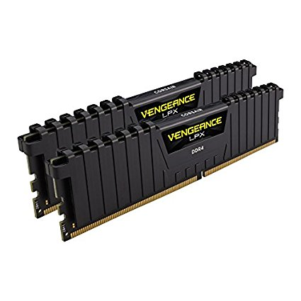
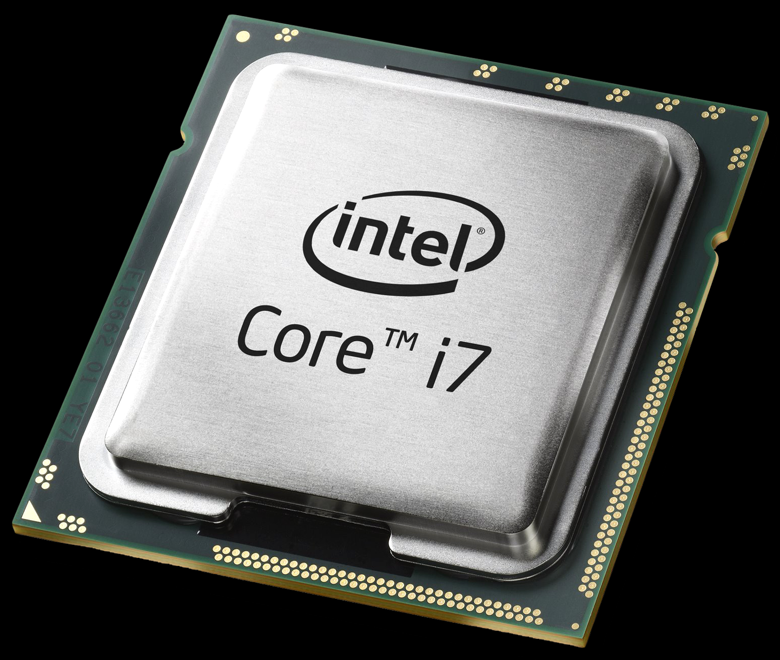
How CPU Works?
Outside World
Outside Memory
CPU

Slide 4
How CPU Works?
?
Simplified CPU actions:
2
3
a[0] = b[0] + 1
a[0] =
what next?
what to do?
010100…0101
from MEM
Read instruction
Decode it
Read inputs
Execute instruction
Write result
Read next instruction
Decode it
Read inputs
from MEM
to MEM
Outside Memory
CPU
Conclusion: CPU works a lot with Outside Memory

Slide 5
Outside Memory
CPU
CPU

Slide 6
Outside Memory
CPU

Slide 7
Cache
3rd
level
Cache
2nd
level
Cache
1st level
Outside Memory
CPU
10 GB – 1 TB
10 – 30 MB
256 KB – 1 MB
32 KB

Slide 8
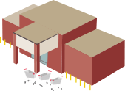


Slide 9
What is inside CPU?

Slide 10
Many thanks!
Questions welcome :)
Alexander Titov
alexander.titov@atitov.com
alexander-titov-cpu

